Slide 1
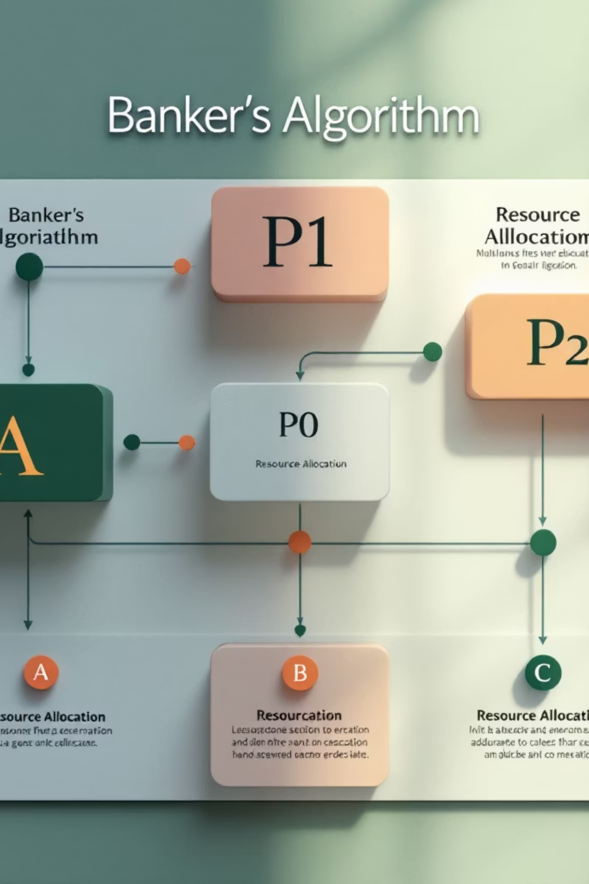
Banker’s Algorithm
Deadlock Avoidance in Operating Systems
Course: Operating Systems
Roll No: 061, 066, 306
Semester: BSCS-V-B

Slide 2








Introduction to Deadlocks
A state where two or more processes are indefinitely waiting for each other to release resources.
Mutual Exclusion
Hold and Wait
Only one process can use a resource at a time.
Process holds resources while waiting for new ones.
Circular Wait
No Preemption
Processes form a circular chain, each waiting for the next.
Resources cannot be forcibly taken from a process.

Slide 3


Deadlock Handling Approaches
Strategies to manage and mitigate deadlocks in an operating system.
Deadlock Prevention
Deadlock Avoidance
Deadlock Detection & Recovery
Negates one of the four necessary conditions.
Dynamically checks resource-allocation state.
Detects deadlocks and then recovers from them.
Banker's Algorithm is a prominent Deadlock Avoidance technique.

Slide 4
What is Banker’s Algorithm?
Safe State
Ensuring system safety through a resource allocation strategy.
A state where the system can allocate resources to each process (up to its maximum) in some order and still avoid deadlock.
Proposed by Edsger Dijkstra: A pioneering concept in OS resource management.
Banking System Analogy: Named for its parallel to how banks ensure
they can meet all customer demands.
Never Enters Unsafe State: Guarantees that the system can always
allocate resources to all processes in some order and avoid deadlock.
Known Max Resource Needs: Requires processes to declare their maximum resource requirements upfront.
Unsafe State
A state that might lead to a deadlock; there is no sequence of resource allocation that guarantees all processes can finish.

Slide 5
Key Data Structures
Fundamental matrices and vectors used in the Banker's Algorithm.
Available
A vector of length 'm' indicating the number of available resources of each type. (e.g., A[j] = k, k instances of resource type j are available)
Max
An n x m matrix defining the maximum demand of each process. Max[i,j] = k means Process P[i] may request at most k instances of resource type R[j].
Allocation
An n x m matrix defining the number of resources of each type currently allocated to each process. Allocation[i,j] = k means Process P[i] is currently allocated k instances of R[j].
Need
An n x m matrix indicating the remaining resource need of each process. Need[i,j] = k means Process P[i] needs k more instances of R[j] to complete its task.
Formula: Need[i][j] = Max[i][j] − Allocation[i][j]

Slide 6






Safety Algorithm (Core Logic)
Determining if the system is in a safe state.
Initialize
Find Process
Allocate
Mark Finish
Repeat
This algorithm iteratively checks if a safe sequence of processes exists, ensuring all processes can complete without deadlock.

Slide 7






Resource Request Algorithm
Check Request ≤ Need
Run Safety Algorithm
Is the request within the process's
declared maximum need
Execute the safety algorithm on
this simulated state.
Check Request ≤ Available
If Safe → Grant
If the simulated state is safe,
commit the allocation.
Are there enough resources currently
available in the system?
Pretend Allocation
Else → Rollback
Temporarily allocate resources to
simulate the new state..
If unsafe, deny the request and
restore the previous state.

Slide 8
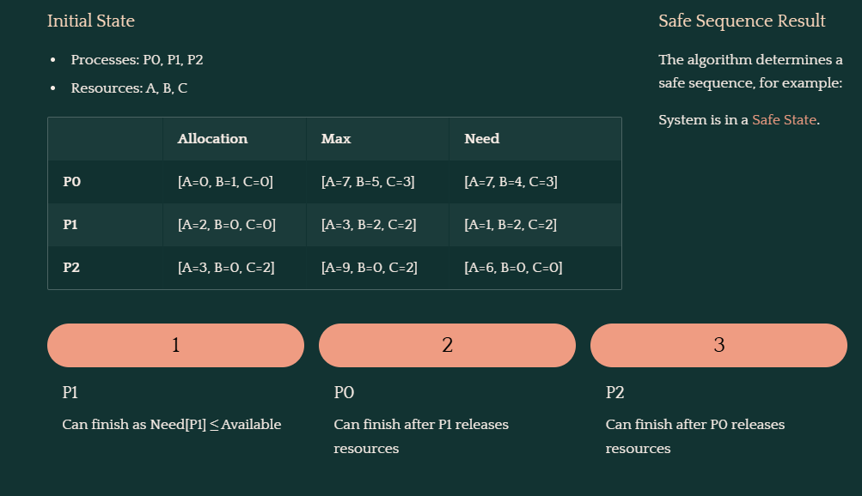
Worked Example
A numerical illustration of the Banker's Algorithm.
Initial State
Available Resources: 3, 3, 2
Safe Sequence Result
Processes: P0, P1, P2
Resources: A, B, C
The algorithm determines a safe sequence, for example:
System is in a Safe State.
Available: [A=3, B=3, C=2]
Allocation
Max
Need
P0
[A=0, B=1, C=0]
[A=7, B=5, C=3]
[A=7, B=4, C=3]
P1
[A=2, B=0, C=0]
[A=3, B=2, C=2]
[A=1, B=2, C=2]
P2
[A=3, B=0, C=2]
[A=9, B=0, C=2]
[A=6, B=0, C=0]
1
2
3
P1
P0
P2
Can finish as Need[P1] ≤ Available
Can finish after P1 releases resources
Can finish after P0 releases resources

Slide 9
Advantages, Limitations & Conclusion
Advantages
Limitations
Effectively prevents deadlocks.
Ensures the system remains in a safe state.
Provides predictable resource management.
Requires prior knowledge of maximum resource needs.
Incurs high computational overhead.
Not suitable for highly dynamic systems.
The Banker’s Algorithm is a powerful tool for deadlock avoidance, ensuring system stability by meticulously checking for a safe sequence before any resource allocation.

Slide 10
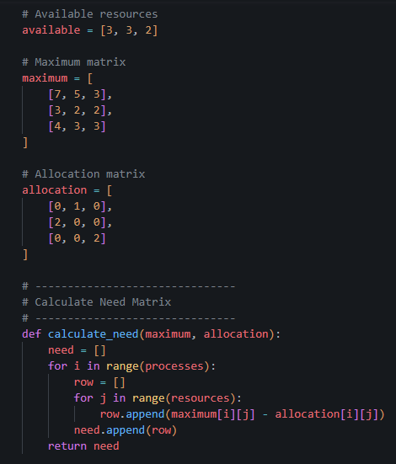
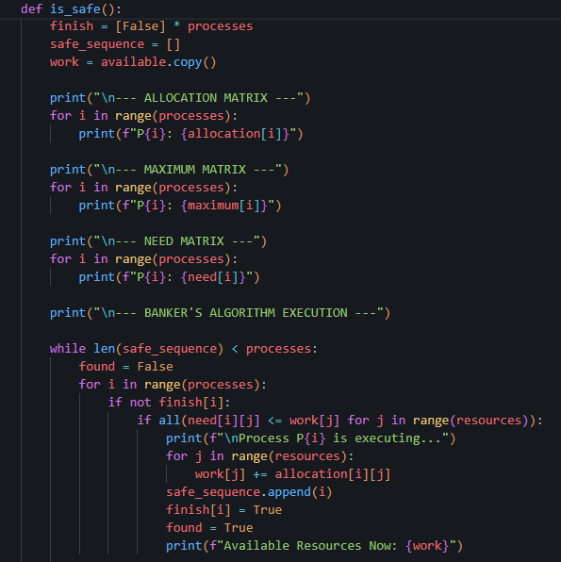
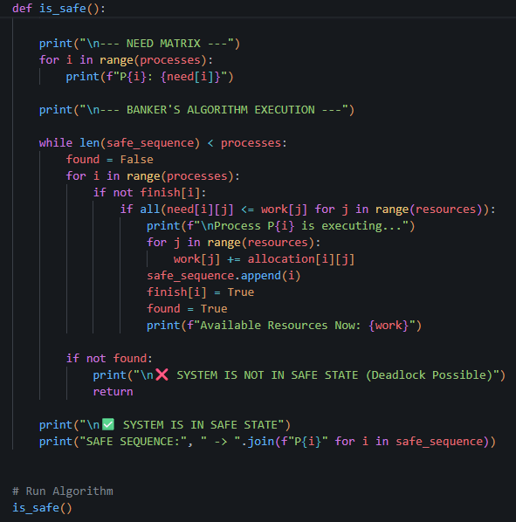

Slide 11
